Slide 1
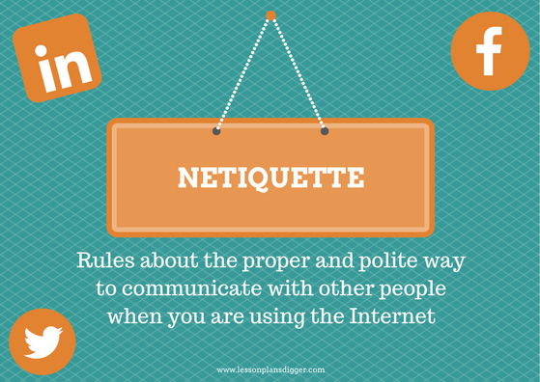

Netiquette
This Photo by Unknown Author is licensed under CC BY-SA-NC
AmeriCorps Presentation
Author Steven C. Wong
4/1/2022
This Photo by Unknown Author is licensed under CC BY-SA

Slide 2

Netiquette
the correct or acceptable(polite) way of communicating on the internet.
This Photo by Unknown Author is licensed under CC BY-NC-ND

Slide 3

Why is netiquette important:
This Photo by Unknown Author is licensed under CC BY-SA-NC
Oral or in-person communication has the benefit of body language, tone of voice and facial expressions that add to the communication between sender and recipient. Written communication is devoid of this luxury, often making the writer’s intent unclear.
This is the primary reason for the presence of online etiquette—to allow us to communicate well virtually. Most websites and social media platforms have defined the rules of online behavior that users must follow.
Such codes have been put in place to ensure people interact effectively and avoid conflicts. There can even be legal implications of not following net etiquette.

Slide 4

Netiquette Examples:
Now that you’ve understood the meaning of netiquette, here are some examples of netiquette or online etiquette:
1. SPECIFY CONTEXT:
Whether you’re replying to an email, participating on a discussion thread or commenting on a social media post, it’s good net etiquette to quote from the original message to give context to your reply
2. READ BEFORE RESPONDING:
Look before you leap, read before you respond! Before you hit send on your rejoinder to an email or a post, confirm twice that your message conveys exactly what you intended. The smallest error or the wrong word could change the meaning of your message.
3. REMEMBER WHO’S AT THE OTHER END:
Never forget that though all you see is a digital screen, you’re interacting with a person with feelings and beliefs on the other side. It can be easy to say things online that you wouldn’t face to face. But rudeness is just as unacceptable
This Photo by Unknown Author is licensed under CC BY-NC-ND

Slide 5

Netiquette Examples part 2
4. SPREAD THE KNOWLEDGE:
The internet was conceived to share information with others. It’s excellent online netiquette to share your knowledge and help those looking for assistance. The cyber world grows by many people sharing and leveraging their knowledge. Sharing only enriches your own knowledge further
5. DON’T PLAGIARIZE:
We often see people using information and quotes from unknown sources. The internet has given us access to all kinds of information that we can share or use. However, make sure to properly attribute it to the correct author(s)
6. REIN IN THE SARCASM:
Be cautious of making sarcastic comments. The recipient has the disadvantage of not hearing your tone of voice or seeing your facial expressions. Sarcasm can be misunderstood and spoil relationships. You can use emoticons (sparingly) or prefix your reply with something like, “On a lighter note…” But, it’s always safe to be professional and straightforward
7. NEVER SPAM:
Don’t we all hate junk messages? The same applies to our friends and colleagues. Refraining from sharing irrelevant, unverified content and rumors is the way to go
8. DON’T SHOUT:
An important piece of online etiquette is to avoid writing whole words or sentences in capital letters. This is considered rude and akin to someone yelling at you
This Photo by Unknown Author is licensed under CC BY-NC-ND

Slide 6

Netiquette examples Continued
7. INTRODUCE YOURSELF:
Another piece of internet etiquette that’s often overlooked is a failure to identify ourselves as the author of a message. It’s polite to add your signature at the end of an email
8. PRIVACY IS PARAMOUNT:
Never forward personal emails and photos or share statuses without permission from all involved in the communication. Be extremely careful while sharing personal information about someone and never do so without their consent. Upholding others’ privacy is among the most important online etiquettes. Even if it’s a close friend, exercise caution online
9. RESPOND TO MESSAGES:
Respond to emails or messages on social media platforms promptly. If you’re busy, acknowledge that you’ve received the message and let the sender know when you’ll revert. The simple act of responding on time is a valued part of net etiquette
10. DON’T HIDE:
Using false profiles is not good internet etiquette. Having no picture is only a little better than a false one. Do you wear a mask when meeting people in real life or turn away when talking to them? Online communication is the same. Remember that trolls and cyberbullies use false profiles, so be careful not to be mistaken for one
11. BE AUTHENTIC:
People like to connect with or follow those with original thoughts and opinions. Express yourself openly and honestly. Following net etiquette means you aren’t restricting your expression but being conscious about how you do it
12. RESPECT OTHERS’ VIEWS:
It’s good online etiquette to allow people to express their views. Hold back from belittling opinions different from your own. You can disagree respectfully if you must, but it’s insensitive to disparage other people’s beliefs and thoughts even when they aren’t near you
13. AVOID CONFLICT:
Abusive behavior is the height of bad net etiquette. Some platforms can even ban you for this. Online platforms are tightening their legal frameworks against online bullying. Avoid sharing abusive content or posts that could incite violence
Online etiquettes must be followed strictly to avoid hatred and malpractices spread like wildfire.
This Photo by Unknown Author is licensed under CC BY-NC-ND

Slide 7

The following are consequences of bad netiquette:
This Photo by Unknown Author is licensed under CC BY-NC-ND

Slide 8

Email Netiquette
This Photo by Unknown Author is licensed under CC BY-NC

Slide 9

Texting Netiquette

Slide 10

Question and Answer Slide?
Does anyone have any questions about netiquette?
This Photo by Unknown Author is licensed under CC BY-NC

